Slide 1
INTERACTIVE SYSTEMS WITH MVC ARCHITECTURAL PATTERN
Software Design Architecture Lab # 10 Saniya Sarim

Slide 2
Interactive Systems
Today’s systems allow a high degree of user interaction, mainly achieved with help of graphical user interfaces. The objective is to enhance the usability of an application. Usable software systems provide convenient access to their services, and therefore allow users to learn the application and produce results quickly.

Slide 3
Interactive Systems
When specifying the architecture of such systems, the challenge is to keep the functional core independent of the user interface. The core of interactive systems is based on the functional requirements for the system, and usually remains stable. User interfaces, however, are often subject to change and adaptation. For example, systems may have to support different user interface standards, customer-specific ‘look and feel’ metaphors, or interfaces that must be adjusted to fit
into a customer’s business processes. This requires architectures that support the adaptation of user interface parts without causing major effects to application-specific functionality or the data model underlying the software.

Slide 4
Interactive Systems(Examples)
Smart Phones Applications
Desktops Applications
Web Applications
Smart Devices, smart watch etc..

Slide 5
MVC Architectural Pattern
Model view controller (MVC) is an architectural pattern usually used in web-based applications, Mobile and Desktop applications. It provides three main layers; model, view, and controller. Many developers use MVC as a standard design pattern. It is a complete framework. MVC provide three types of classes

Slide 6
MVC Architectural Pattern(Model)
Model classes are used to implement the logic of data domains. These classes are used to retrieve, insert or update the data into the database associated with our application.
Basically Model class is the entity class.
Model Classes are just like snapshot of your database tables that contains entities/fields similar to database tables helps in CRUD operations.
Models handles data logic like retrieving and transaction of data etc.

Slide 7
MVC Architectural Pattern(Views)
Views as named are User Interfaces that dynamically requested by controller on a particular request.
Views are used to prepare the interface of our application. By using that interface users interact with our application.
Views handles data presentation, dynamically rendered.

Slide 8
MVC Architectural Pattern(Controller)
Controllers handles the request from the server.
It never handles the data logic like transactions from database etc. Example
Server Request(Get Groceries) → GeroceriesController(Handles this request by requesting data from models) → Models(Send their response back to controller) → GeroceriesController(Now interact with View to render the UI for Geroceries)

Slide 9
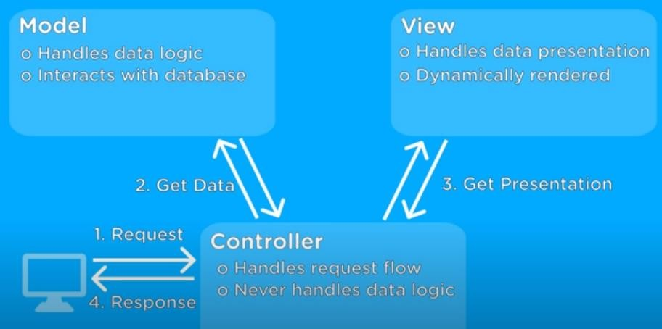
MVC Architectural Pattern

Slide 10
Interactive Systems with MVC Architectural Pattern
In order to build highly interactive interfaces there must be many complex coding and UI have to be implemented.
MVC pattern solves this complex application problem by making separation of concern.
How? (by making each object perform specific responsibility as we learned about MVC is all about)
Example: If I request facebook.com/home i am now requesting home page data → HomeController in Facebook application will handle my this request then it request data for home from models and put them into particular view.

Slide 11
Why and When to Use this pattern?
it helps you create applications that separate the different aspects of the application (input logic, business logic, and UI logic). The main aspect is Loose Coupling.
Manage Complexity.
Simultaneous development: Multiple developers can work simultaneously on the model, controller and views.
Ease of modification: Because of the separation of responsibilities, future development or modification is easier i.e. scalability of the product is increased.

Slide 12
Example Step by Step

Slide 13
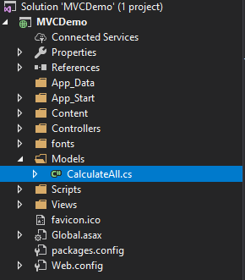
Step1 – Creating Model Class

Slide 14
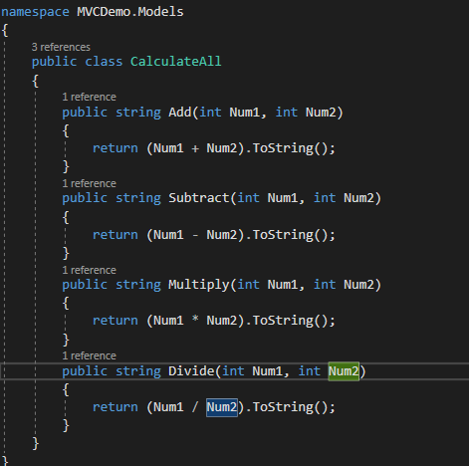
Step1 – Creating Model Class

Slide 15
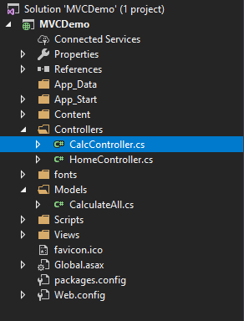
Step2 – Creating Controller Class

Slide 16
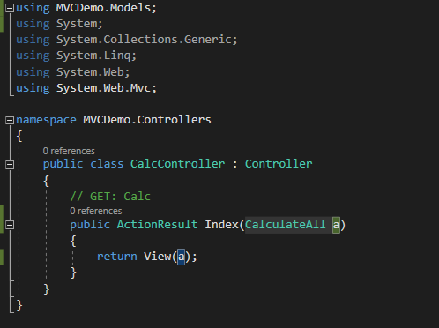
Step2 – Creating Controller Class

Slide 17
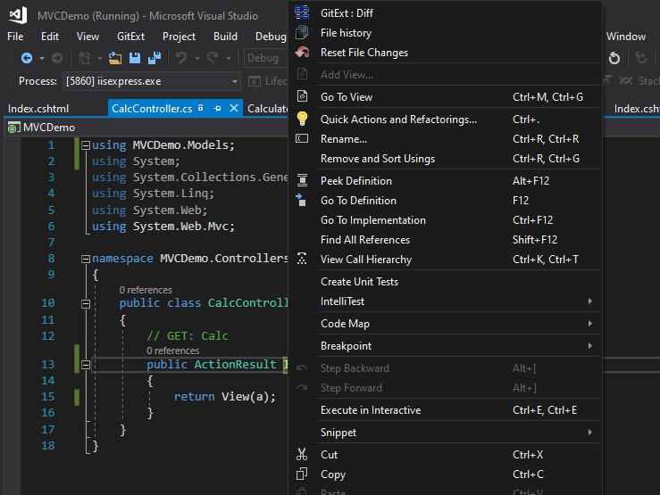
Step3 – Creating view

Slide 18
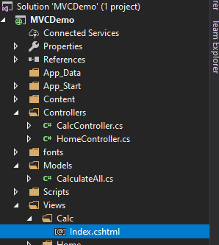
Step3 – Creating view

Slide 19
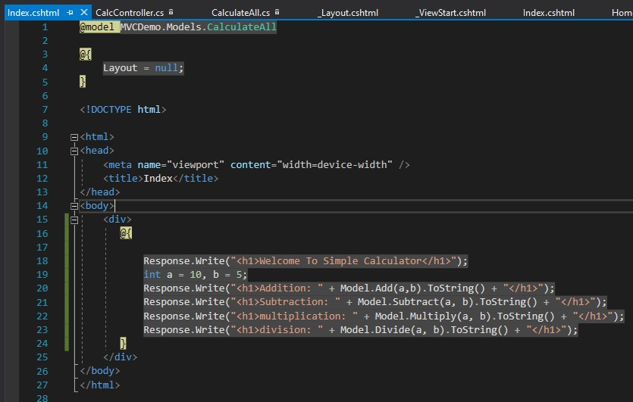
Step3 – Creating view

Slide 20
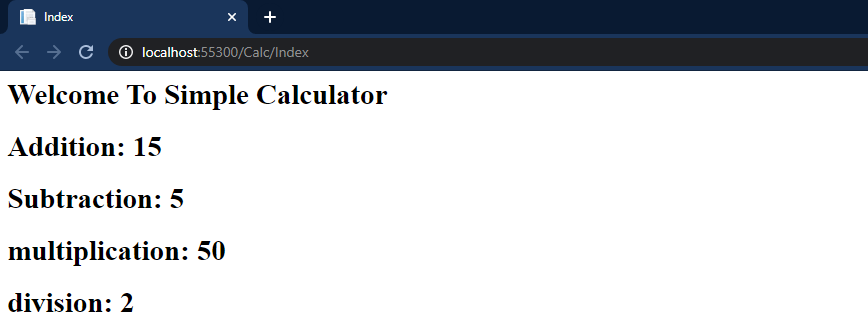
Output

Slide 21
Tasks
Create Complete calculator program using MVC.
Create Basic CRUD Application using MVC.

Slide 22
Helping Links.
1. https://www.youtube.com/watch?v=E7Voso411Vs
(Step-by-step ASP.NET MVC Tutorial for Beginners | Mosh)

